Slide 1
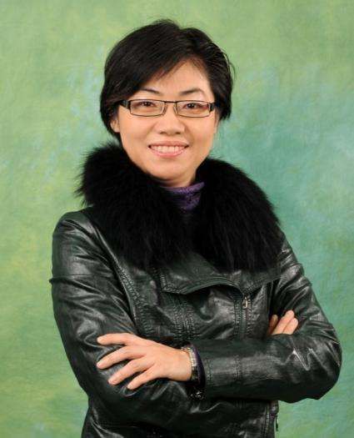
跟隨系統‧邁向永續收入 The Powerful System lead to Residual income
Nora Siu
總顧問經理級 National Supervising Coordinator
四個佣金週期共賺取HK$76,600
HK$76,600 in 4 Commission weeks
本簡報中提到的收入等級純屬舉例說明，無意代表美安香港經銷商的一般收入，也無意表示任何經銷商皆可賺取同等收入。美安香港經銷商的成功與否，取決於其在發展事業時的努力、才能與投入程度。The income levels mentioned in the following presentation are for illustration purposes only. They are not intended to represent the income of a typical Market Hong Kong Distributor, nor are they intended to represent that any given Independent Distributor will earn income in that amount. The success of any Market Hong Kong Independent Distributor will depend upon the amount of hard work, talent, and dedication which he or she devotes to building his or her Market Hong Kong Business.

Slide 2
The Golden Circle (一個簡單的思考策略，先從由訊息背後的原因、理念、或是價值出發，訴諸“為什麼”才是說服與改變人們決定的核心。)
甚麼
What
如何
How
為甚麼
Why

Slide 3
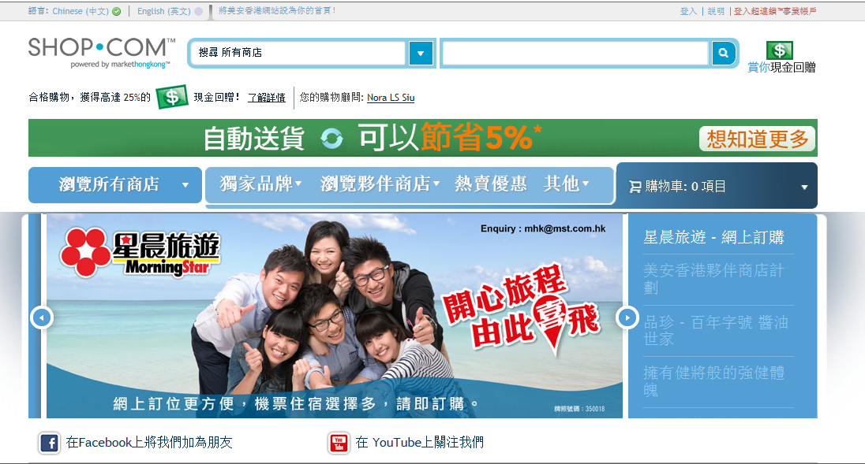

Slide 4
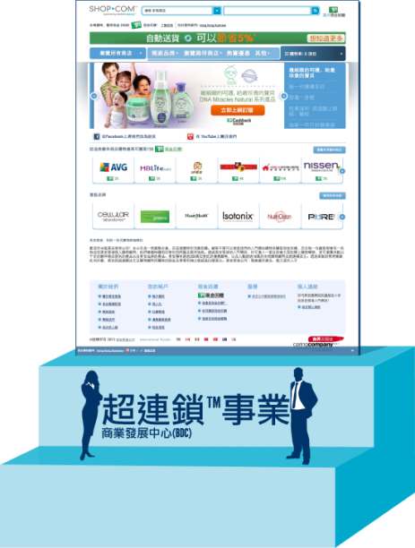
The UnFranchise Business – A 2 To 3 Year Plan
與連鎖事業相同之處：
•系統化、標準化、一致化
•最先進的管理系統 •商品陳列與行銷工具
•標準化的訓練系統
•可擁有多個業務地點
•日益增高的知名度
LIKE A FRANCHISE:
• Systemization, standardization, uniformity
• State-of-the-art management systems • Merchandising and marketing tools
• Standardized training systems
• Potential tax advantages
• Growing visibility
與連鎖事業不同之處：
•無需繳付連鎖權利金
•無需繳付月費
•沒有地域限制
•可兼職創業，時間彈性
•創業成本低
•低風險
UNLIKE A FRANCHISE:
• No franchise fees
• No monthly royalties
• No territorial restrictions
• Start part time with flexible hours
• Minimal startup expenses
• Little risk

Slide 5
美安香港獨家品牌
mhk exclusive brands

Slide 6
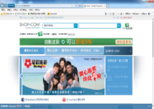
垂直行銷組織架構 Vertical Marketing Organization Structure
• 集結眾人的努力
• 鼓勵團隊合作／支援
• 人人皆享100%的銷售和業績成果
• Compounding efforts
• Encourages teamwork and support
• Everyone receives 100% credit for sales and volume generated
Notes:
6

Slide 7
成立於1992年
FOUNDED
IN 1992
今曰
TODAY
美安香港是一間產品分銷及互聯網銷售公司，
專門從事一對一行銷與社交購物
Market Hong Kong is a Product Brokerage and Internet Marketing Company that specializes in One-to-One Marketing and Social Shopping.

Slide 8
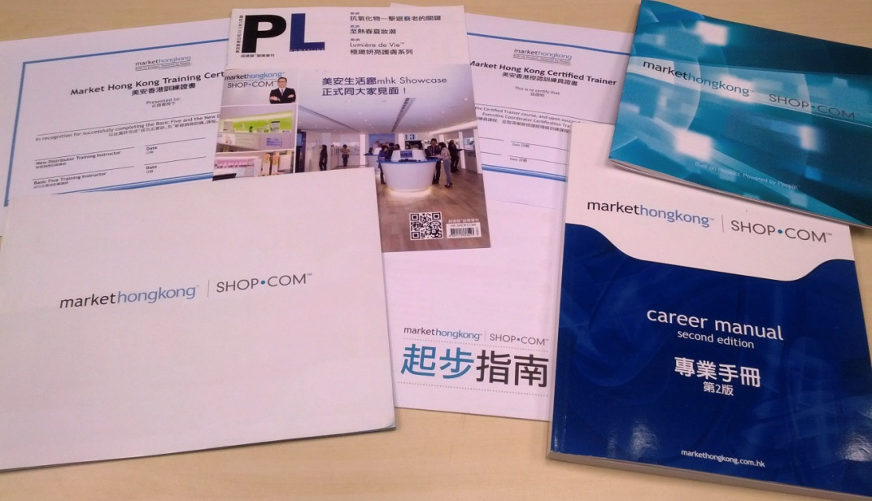
經營事業的支援工具及訓練
Business Support Tools & Trainings
16
Notes:
8
TRAINER’S NOTES:
We provide ongoing training for all areas of interest. We have sales support tools and training.
A proven business plan with our Career Manual
Growing visibility with our branded Web Portal
Management systems with UFMS that allow you to measure and monitor your organizations activities.
Merchandising and marketing tools with specialized training
Ongoing training through our NMTSS
Training is available for UFMS on www.UnFranchiseTraining.com

Slide 9
The Golden Circle (一個簡單的思考策略，先從由訊息背後的原因、理念、或是價值出發，訴諸“為什麼”才是說服與改變人們決定的核心。)
甚麼
What
如何
How
為甚麼
Why

Slide 10
美安大學
Notes:
TRAINER’S NOTES:
Review the University concept of choosing a Major and Minor.
Focus your education to that area of the business that you have interest or fulfills your goals.
Examples:
Health & Nutrition – Wellness Consultant
Transitions – Weight Management Coach
WebCenter – WebSite development
Motives – Cosmetic consultant
nutraMetrix – Working with Health Professionals
Telecommunications
Anti-Aging

Slide 11
成功五要訣
事業經營的基本原則
1. 建立態度與知識
2. 目標與目標宣言
3. 零售
4. 發掘人選、招募人才以及推薦新經銷商
5. 跟進追蹤與ABC模式
Basic 5
Fundamentals of the Business
Developing Attitude and Knowledge
Goals and A Goal Statement
Retailing
Prospecting, Recruiting and Sponsoring
Follow-Up & The ABC Pattern of Building Depth
Notes:
11
11
11

Slide 12
The Golden Circle (一個簡單的思考策略，先從由訊息背後的原因、理念、或是價值出發，訴諸“為什麼”才是說服與改變人們決定的核心。)
甚麼
What
如何
How
為甚麼
Why

Slide 13
一個香港人的故事…… A story about a Hong Kong people……

Slide 16
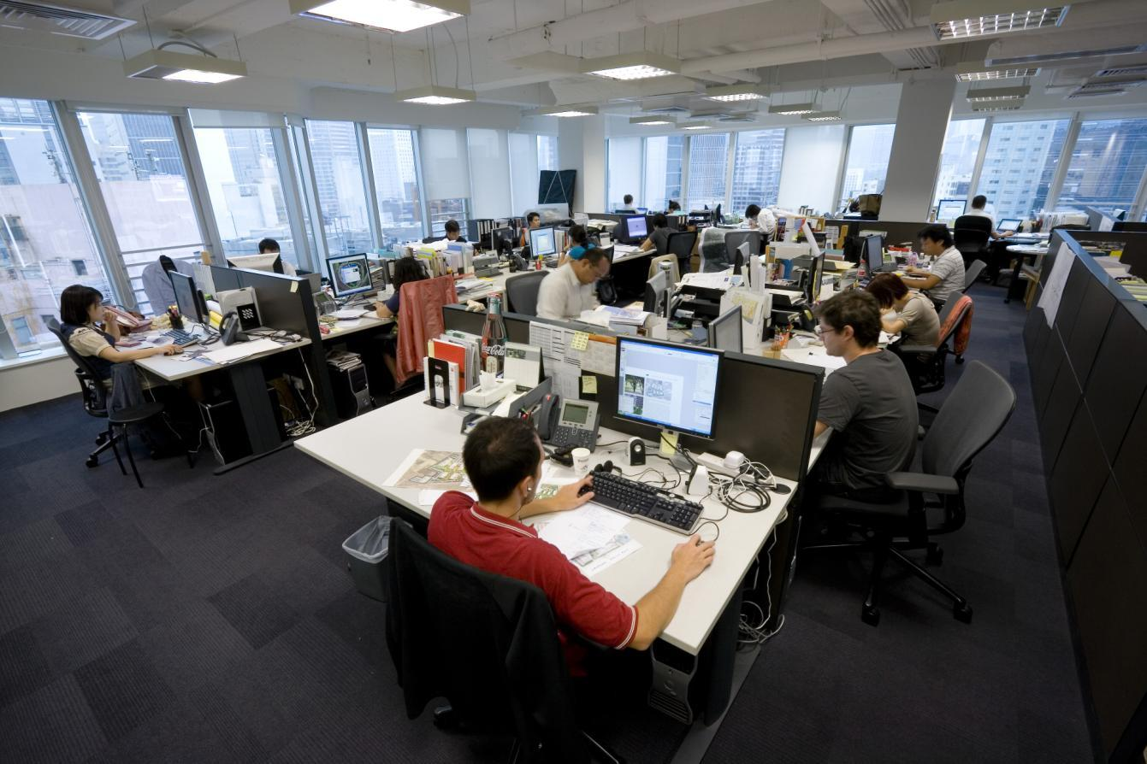
Notes:
也有打工命 .......

Slide 19
做老闆 …好…自己作主… Being a boss… Good… Control everything…

Slide 20
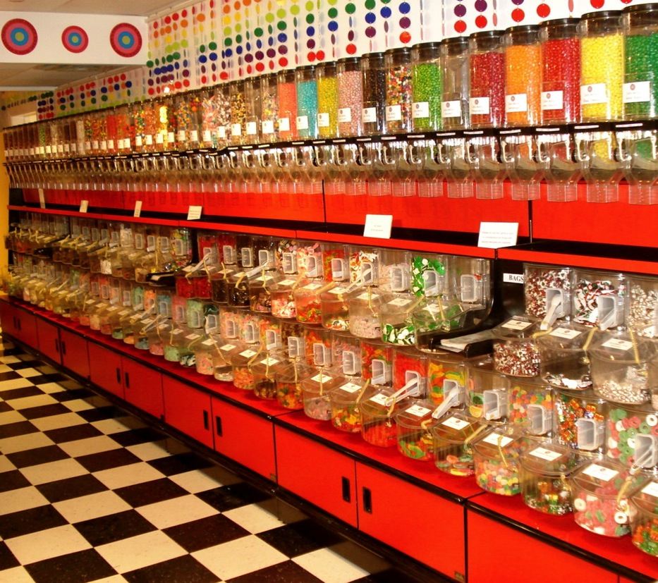

Slide 21
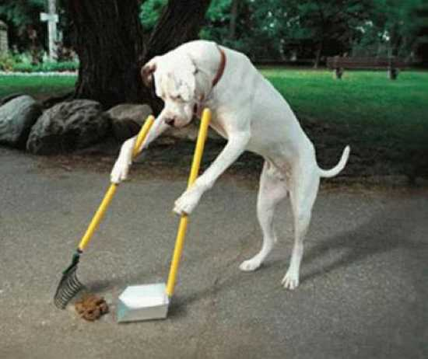

Slide 22
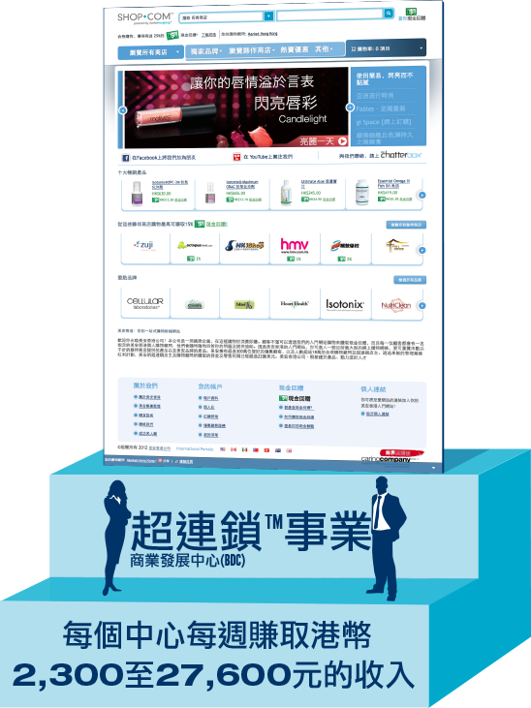
選擇了2到3年計劃
Chose 2-3 years plan
2到3年計劃
2-3 years plan

Slide 25
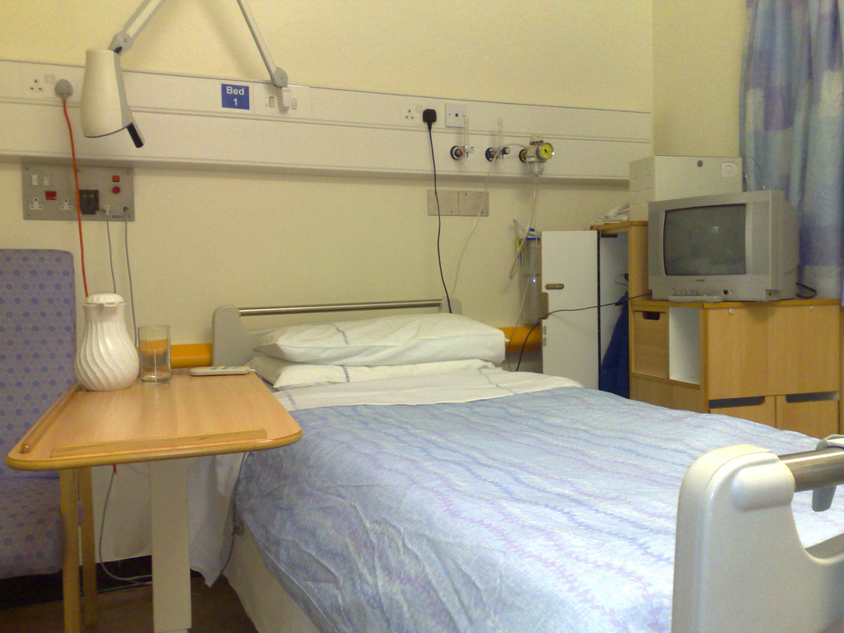

Slide 27
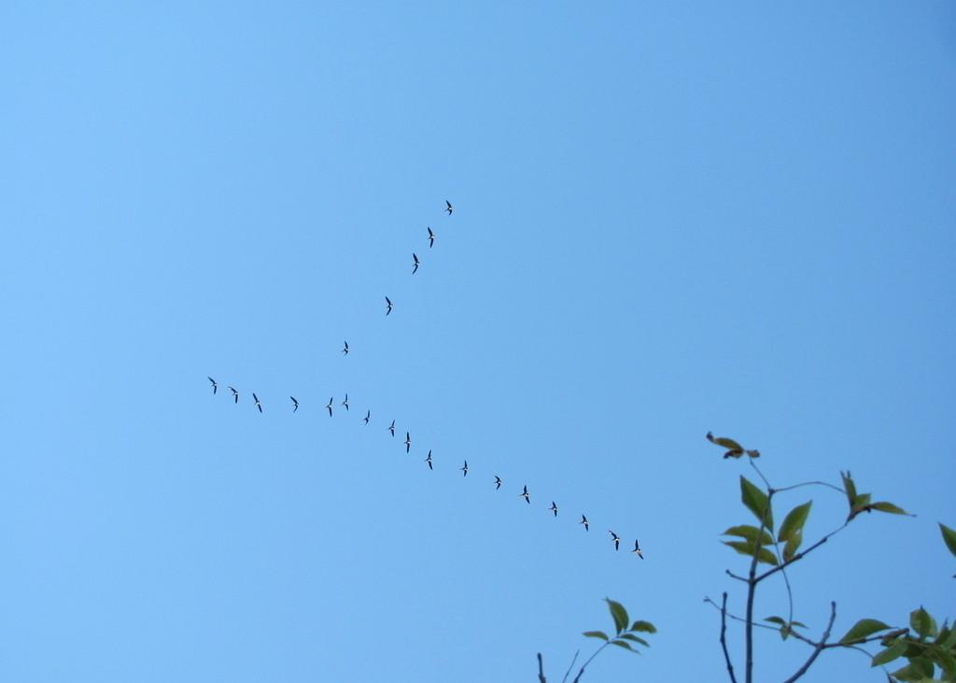

Slide 28
嶄新的公司，嶄新的機會，嶄新的你
2014美安香港年會
mhk Annual Convention
#MHKAC2014

